Slide 1

Dr. Akbas
Joseph Alesandrini
Sarah Gleixner
Olivia Meholic
Troy Neubauer
Nicolas Rodriguez
Jeremiah Webb
Notes:
Nick

Slide 2
A public website that will enable users to filter through a database of cybersecurity tools depending on their needs (commercial, personal, etc.) and generate a report summarizing all recommended tools
Description
Notes:
Nick

Slide 3
Project Background
Does not exist (at least in public market)
Need for an unbiased categorization of industry-used cyber tools
What makes an industry standard for cyber tools?
Notes:
Nick

Slide 4
Customer Needs
System receives user preferences and outputs tools tailored to preferences
System provides info for user-queried tools
System saves user preferences and output for later
Ability To Store Researched Tool Data
Notes:
Nick

Slide 5
Business Solution - CyberTools
Website that can be accessed on the internet
Access Control to upload data
Filterable Cyber Tool Database
Decrease Research Time for security solutions
Cyber Tool Recommendations
Notes:
Joe

Slide 6
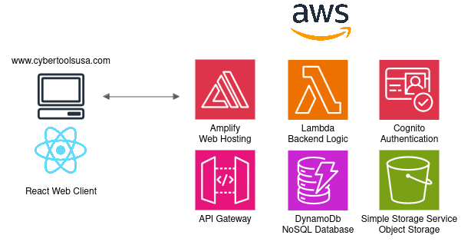



Technical Solution
CyberTools
Notes:
Jeremiah

Slide 7
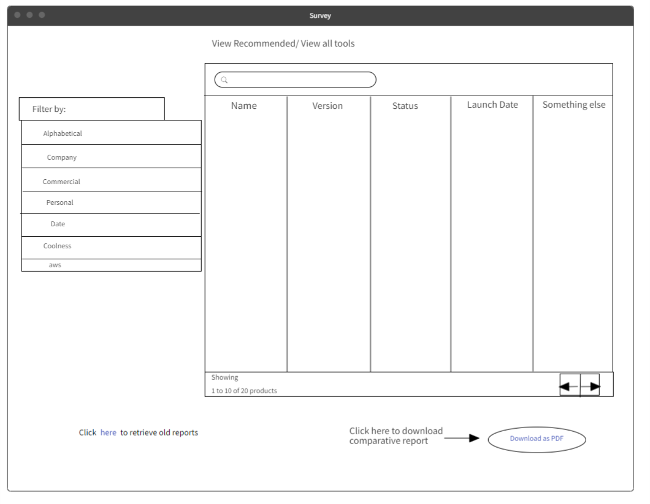
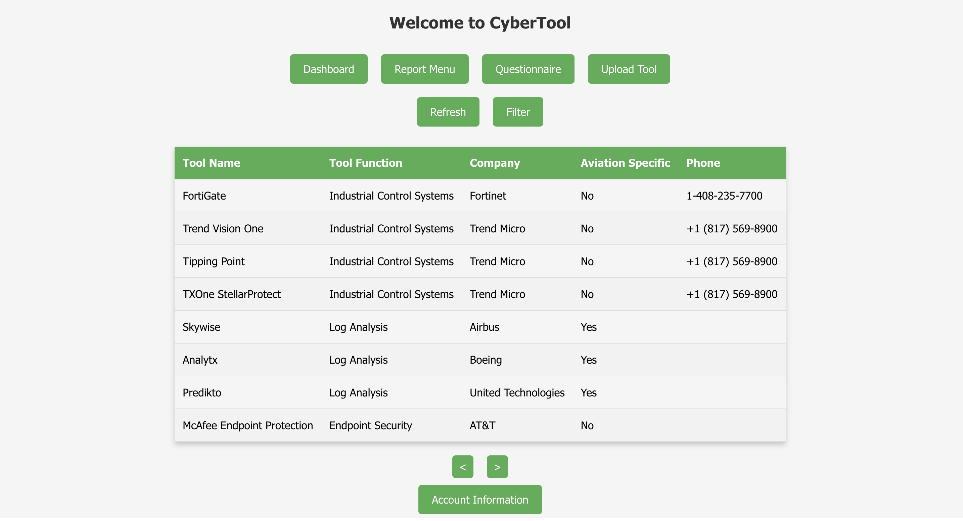

Wireframe vs. Product: Dashboard
Notes:
Olivia

Slide 8
Tool Research
20 Industrial Control System Tools reviewed & uploaded
5 VPN related tools reviewed & uploaded
5 Cybersecurity Service Providers added
Notes:
Joe

Slide 9
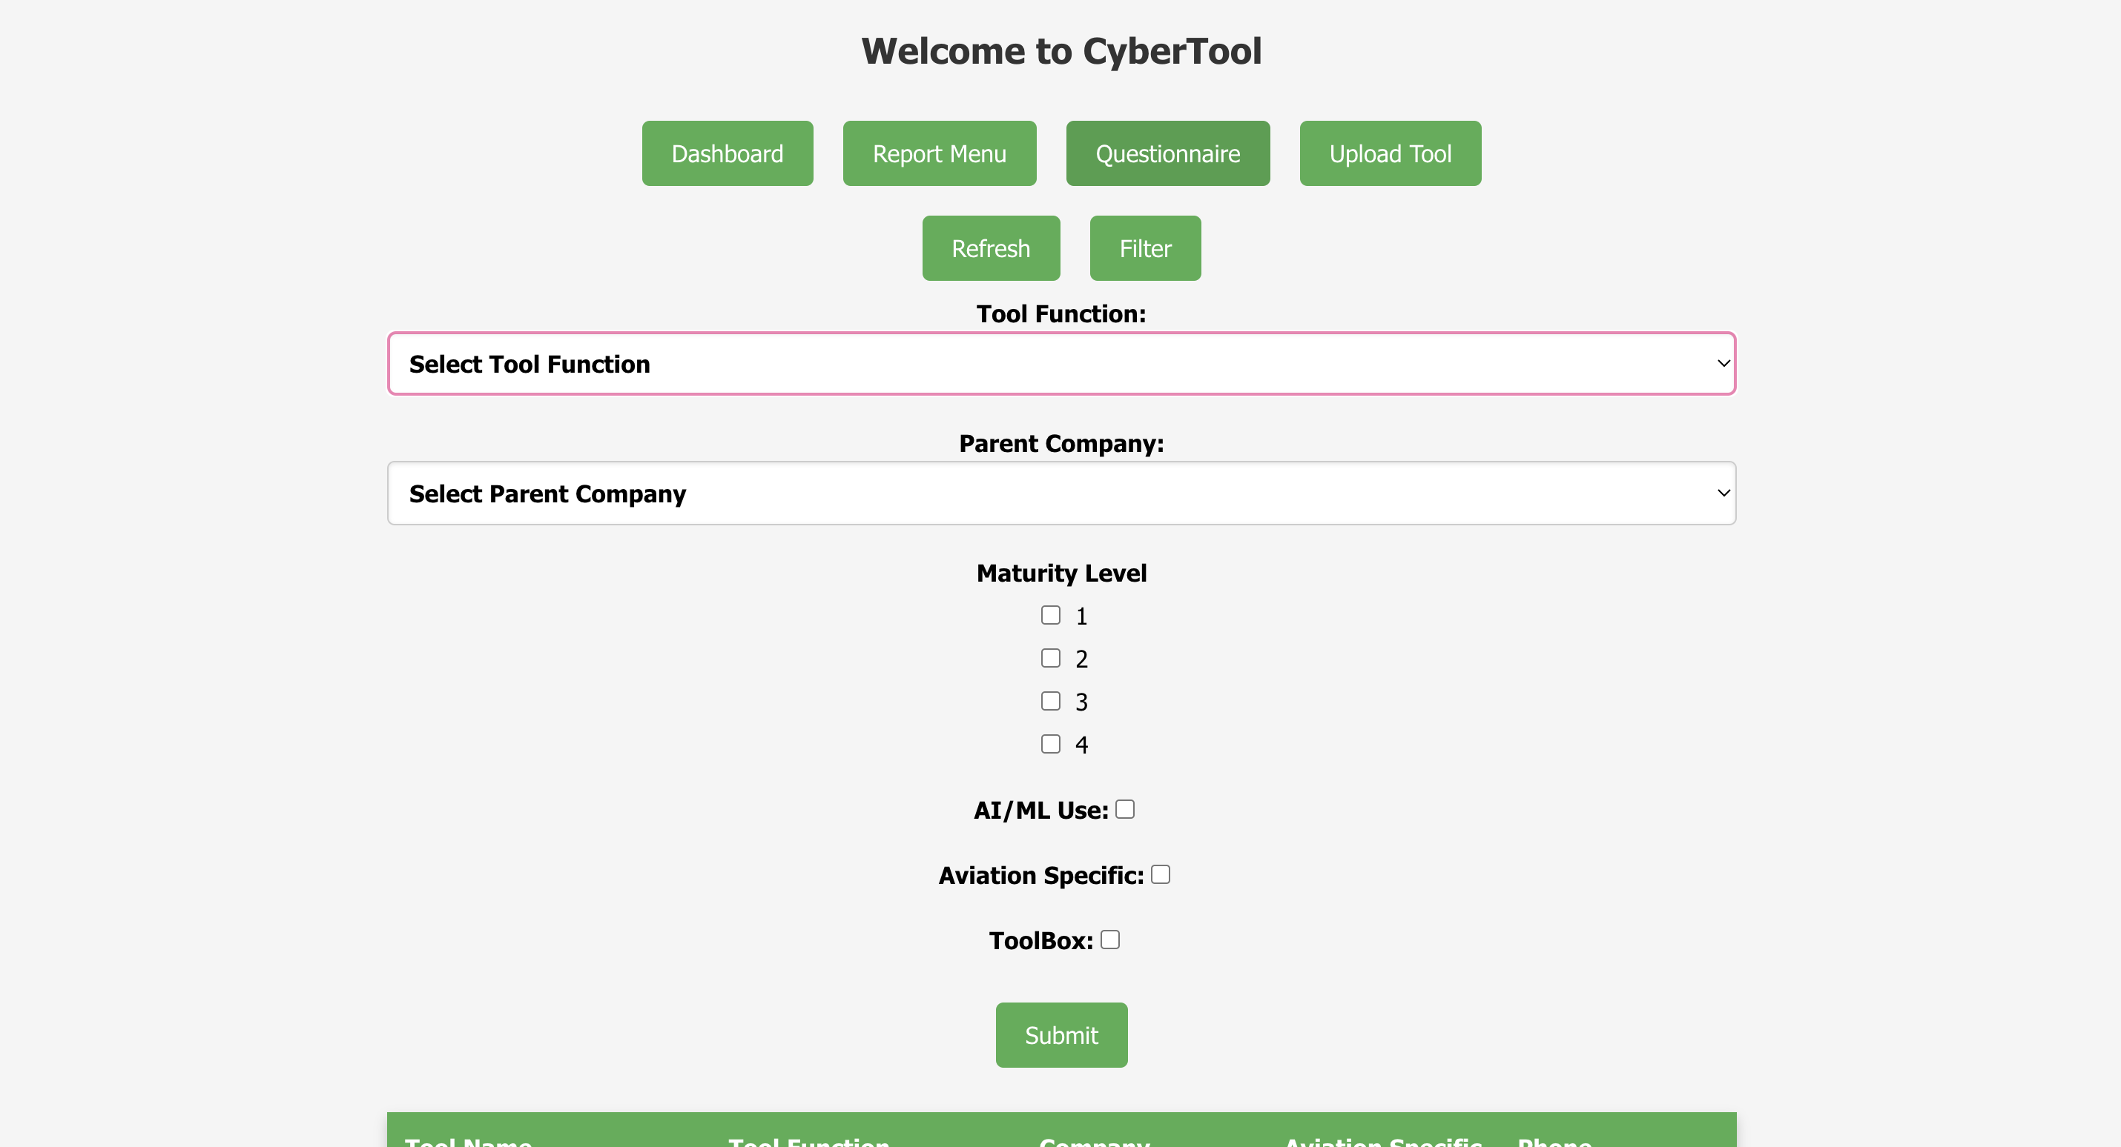
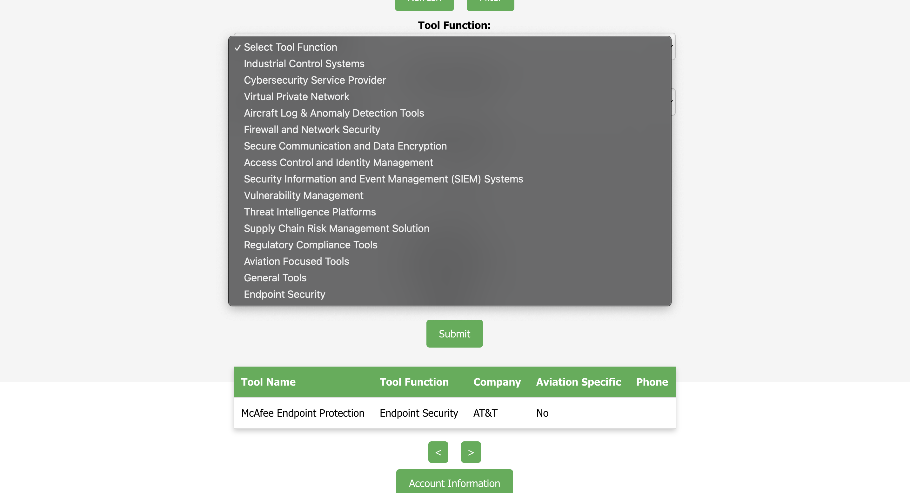
Wireframe vs. Product: Filter
Notes:
Sarah

Slide 10
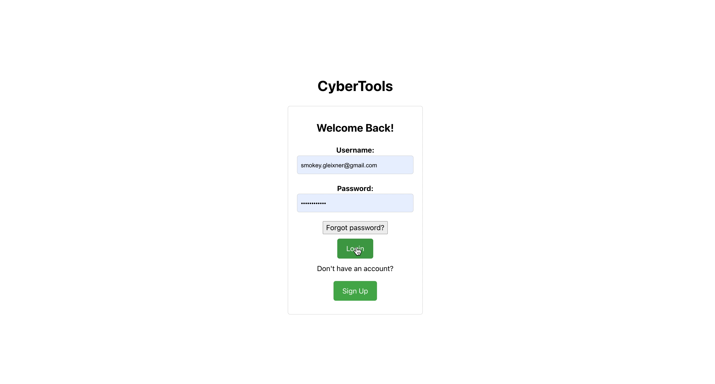
Video Demonstration
Notes:
Sarah

Slide 11
Our Recommendation Approach
Matching multiple-choice survey questions to tools in database
Requires storing information with each tool that is directly related to a survey question
E.g. Storing cloud_capable for each tool
AI search with descriptions
T
Notes:
Troy

Slide 12
Upload Tool Demo
Researchers can add any new categories
Admins only can Approve & Deny
Enables additional options for filtering
Notes:
Jeremiah

Slide 13
Updated Attributes
Accuracy
Approved
Description
Documentation Link
Phone
Notes:
Joe

Slide 14
Updated Research
100 + tools
Expanded upon info
Notes:
Joe

Slide 15
Questionnaire Report Report Menu
Live Demo​
Notes:
Troy

Slide 16
Data Storage
Partition key – Tool Function
Sort key - ID
Example
"Industrial_Control_Systems"
"ICS_07"
Notes:
Joe

Slide 17
Testing
Integration
- Modular Functionality throughout website
- CI tests of frontend and backend on each commit and PR
Functional
- User Stories, Admin vs Guest Users
- Businesses Requirements Tested
T
Notes:
Troy

Slide 18
Future Development
Guest User Functionality
Questionnaire Improvement Based on User Feedback
Logout Functionality
More Filtering Options
T
Notes:
Olivia

